Slide 1
Naukri Web Scrapping Project
Group 2
Mrs. Anuja Phapale
Mrs.Sarika Nitin Zaware
Miss Harshada More
ABIN LAL
Pranita

Slide 2
Business objective
Analysing the Naukri data will also provide better insights, and can be helpful in different ways. If we consider a student/ an aspirant perspective they need to know the pulse of the current job market.
Our Analysis may help them to prepare for their future either in terms of technology, Skills to be earned, salary and lot more
Scraping the web/Naukri data and analyse it. Apply some machine learning models whenever it's necessary.

Slide 3
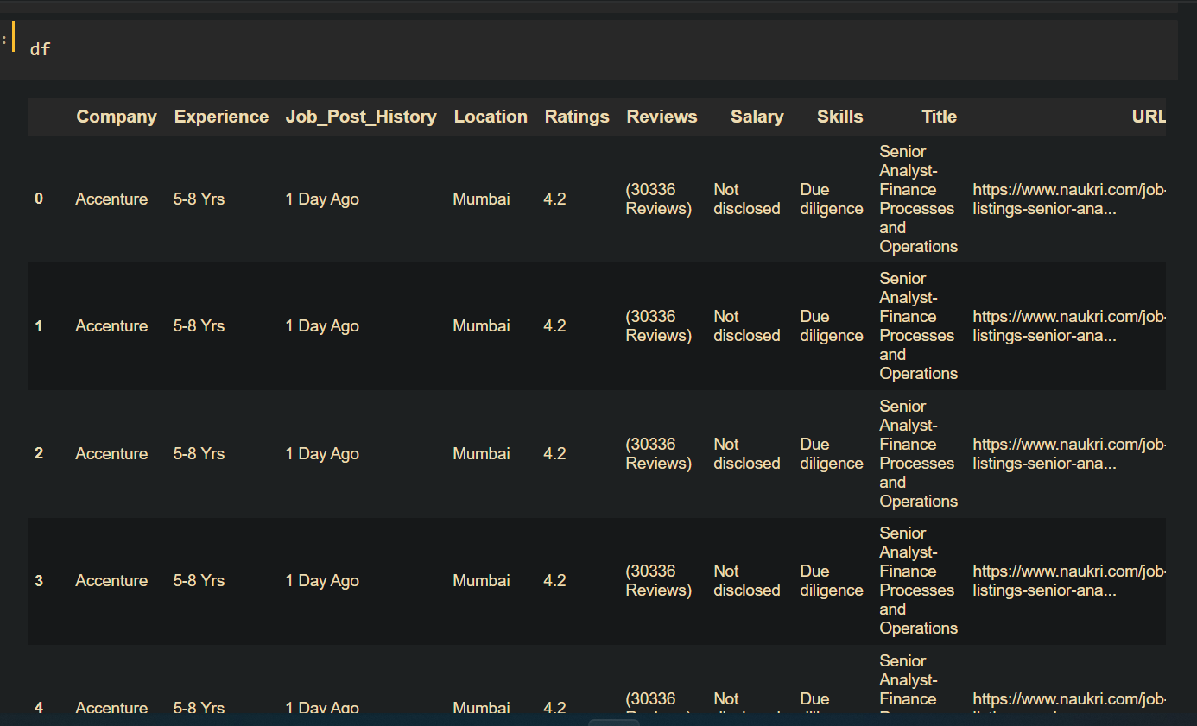
Dataset used

Slide 4
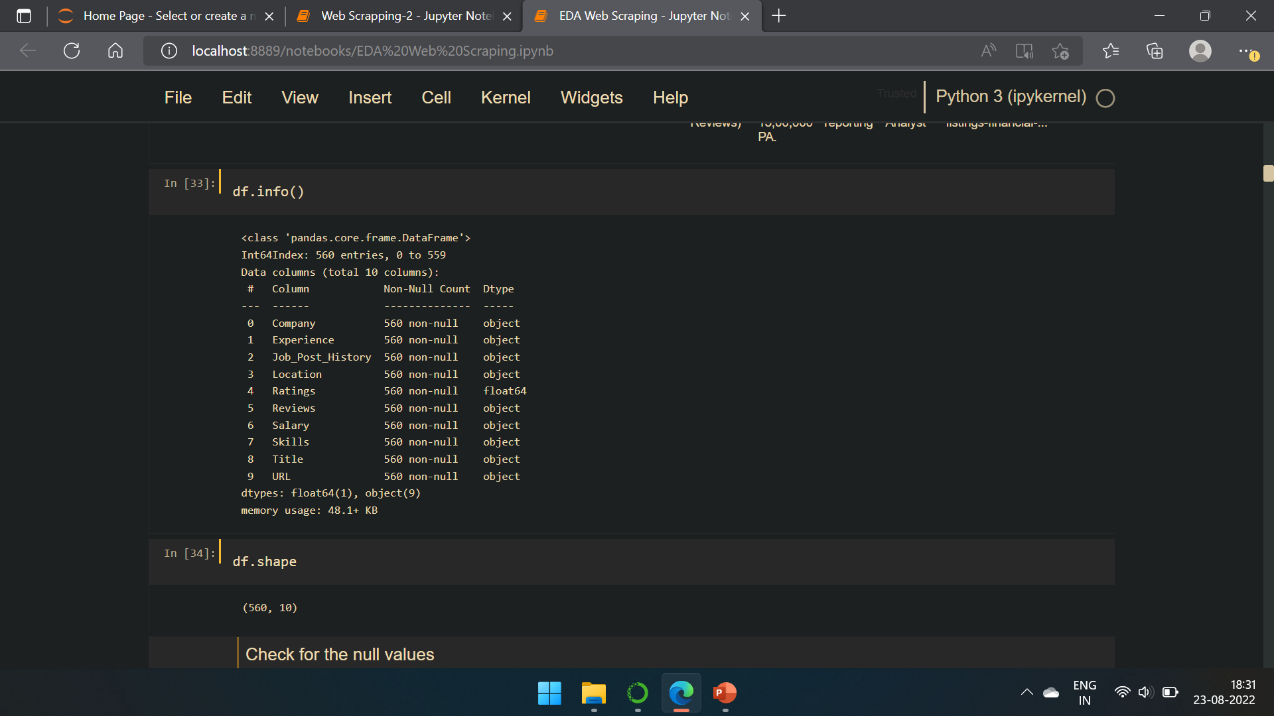
About dataset

Slide 5
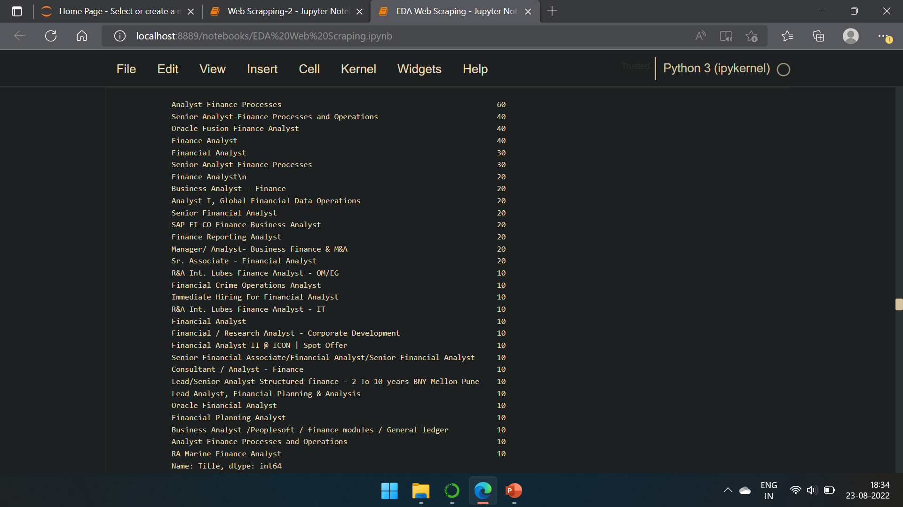
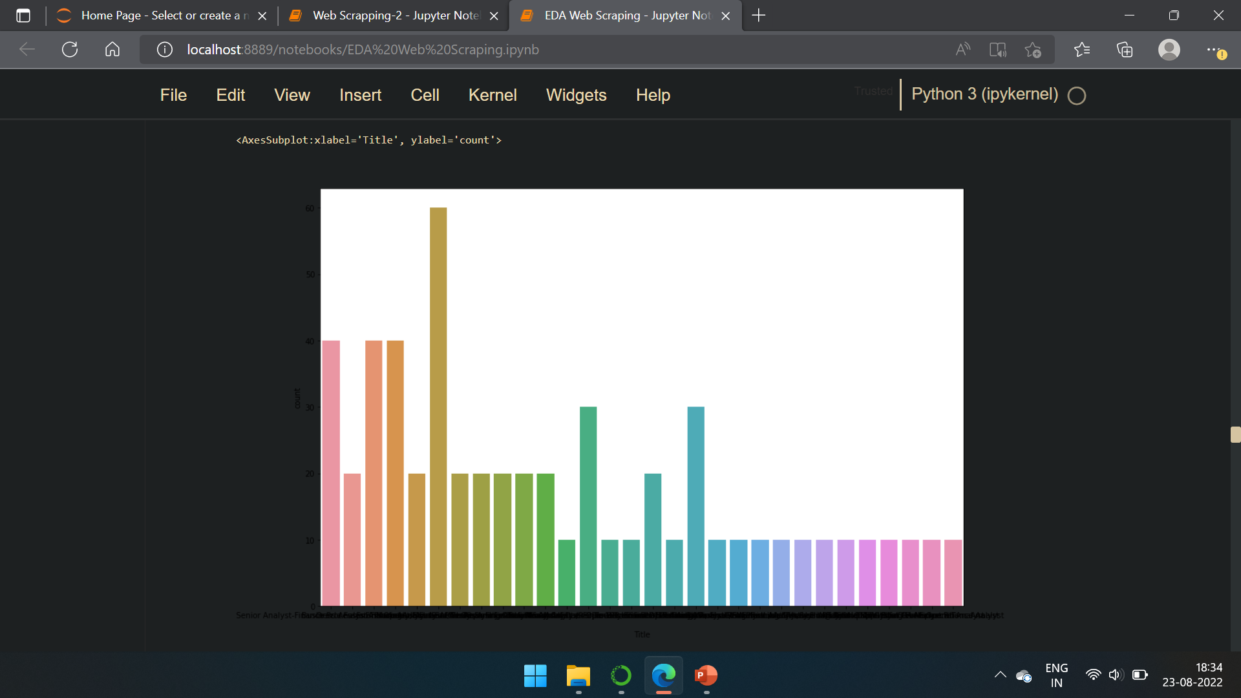
Job titles

Slide 6
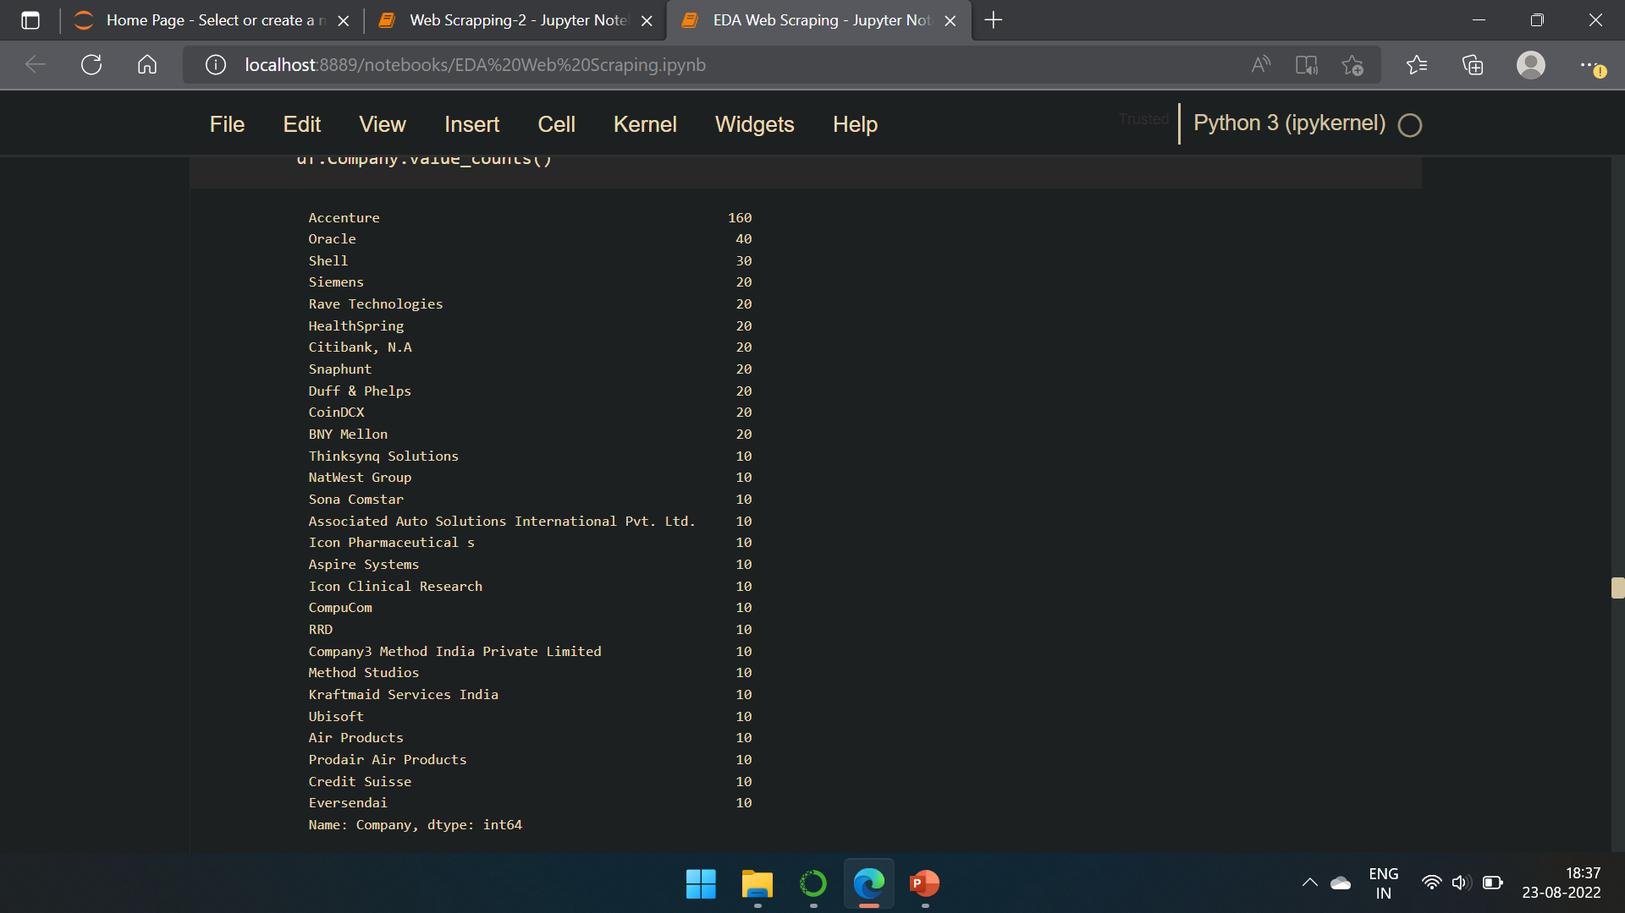
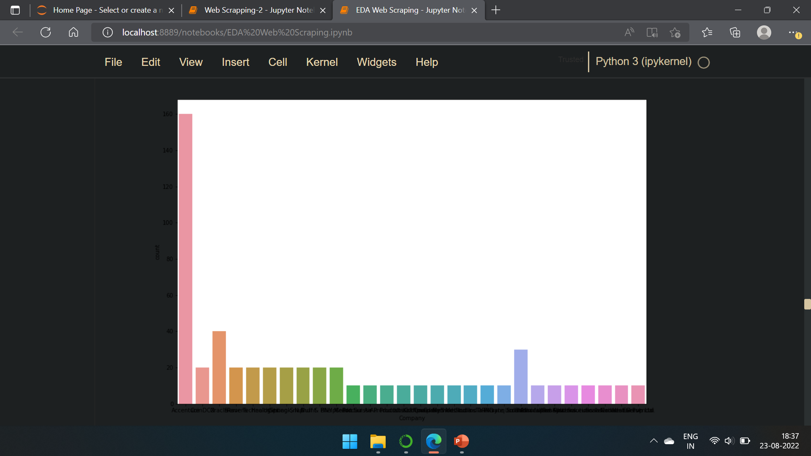
Companies

Slide 7
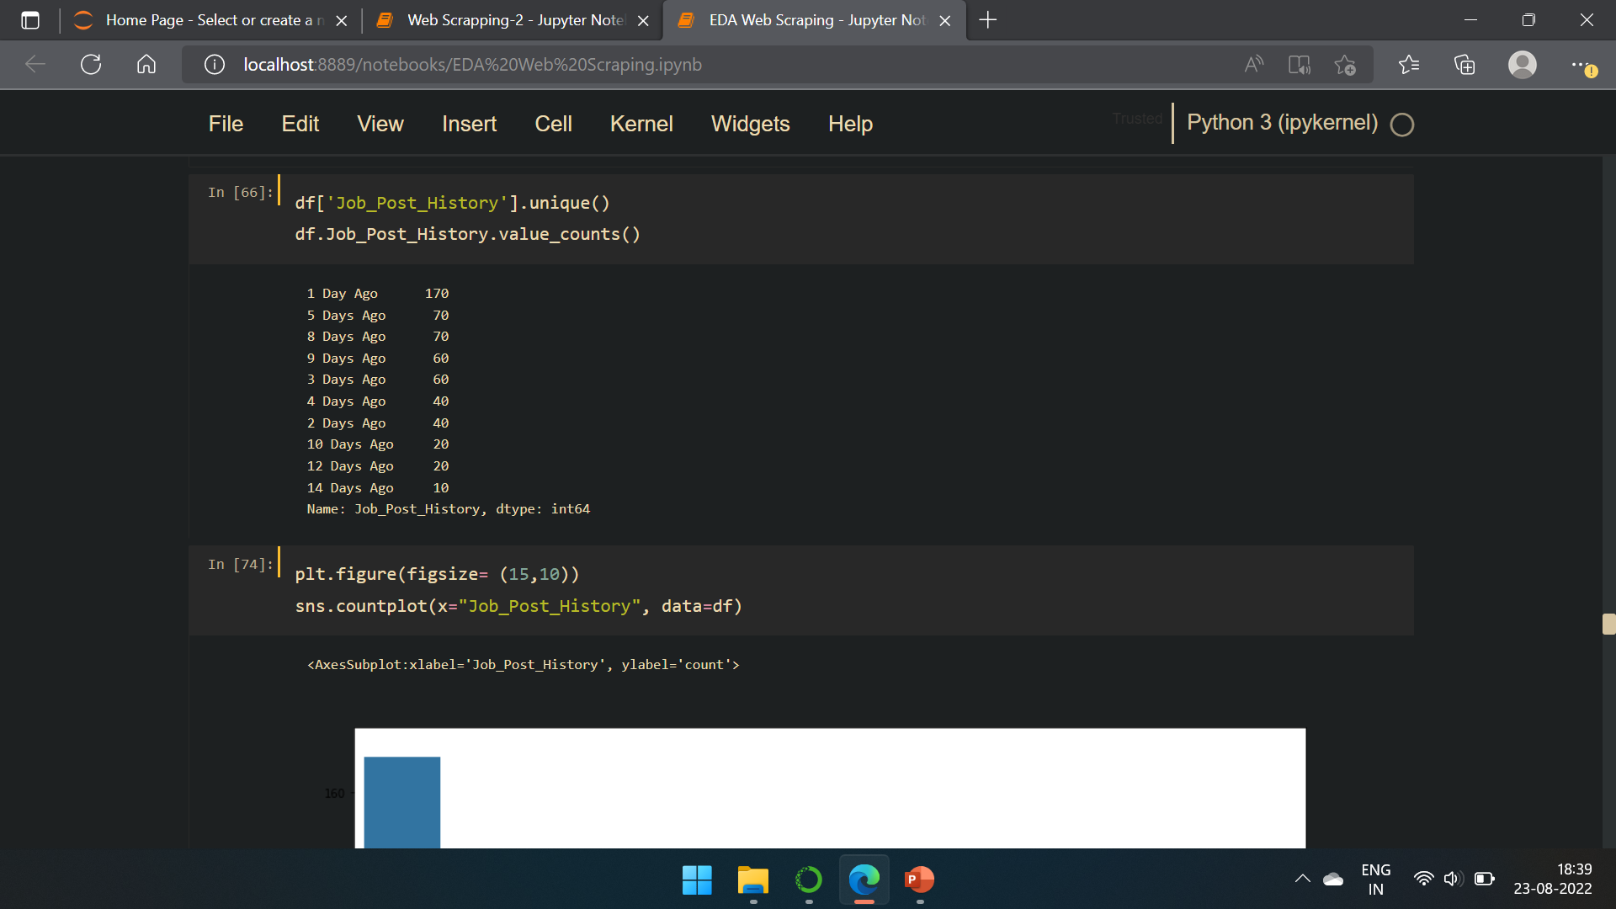
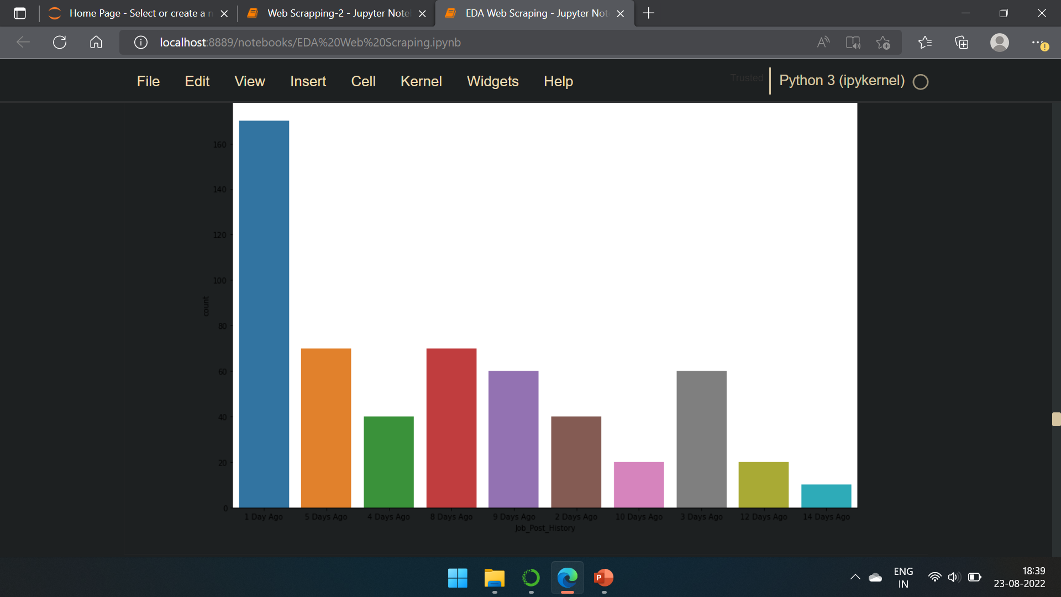
Job post history

Slide 8
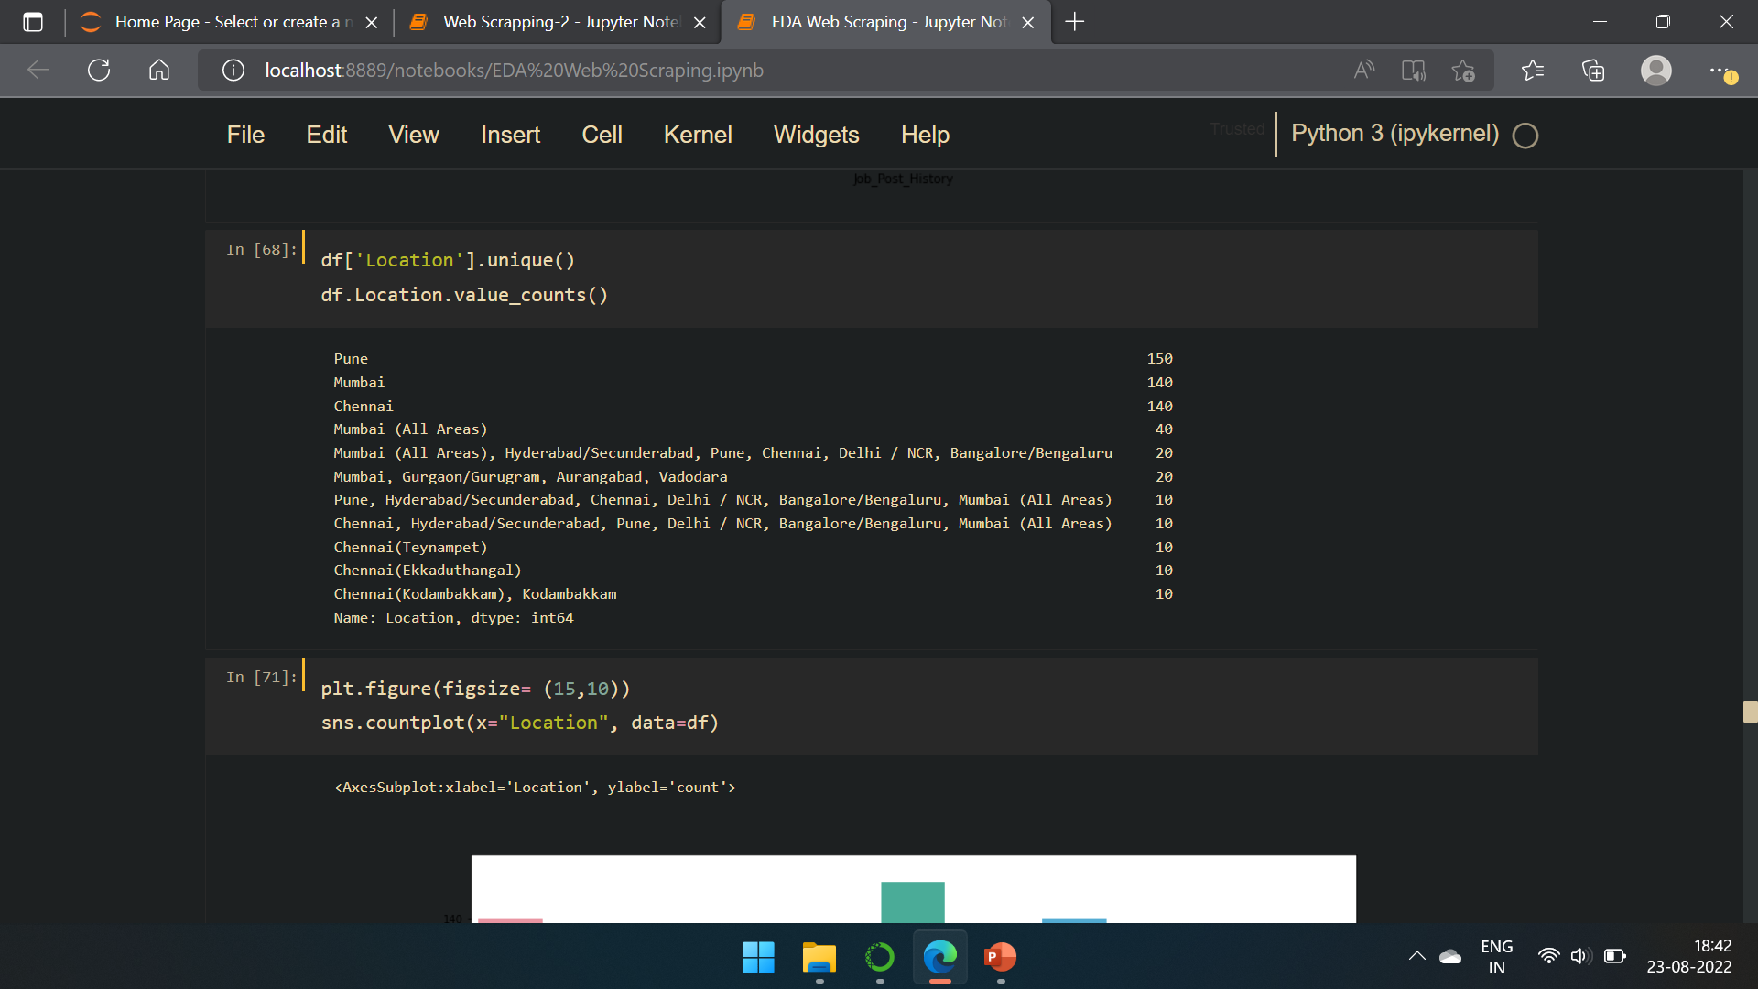
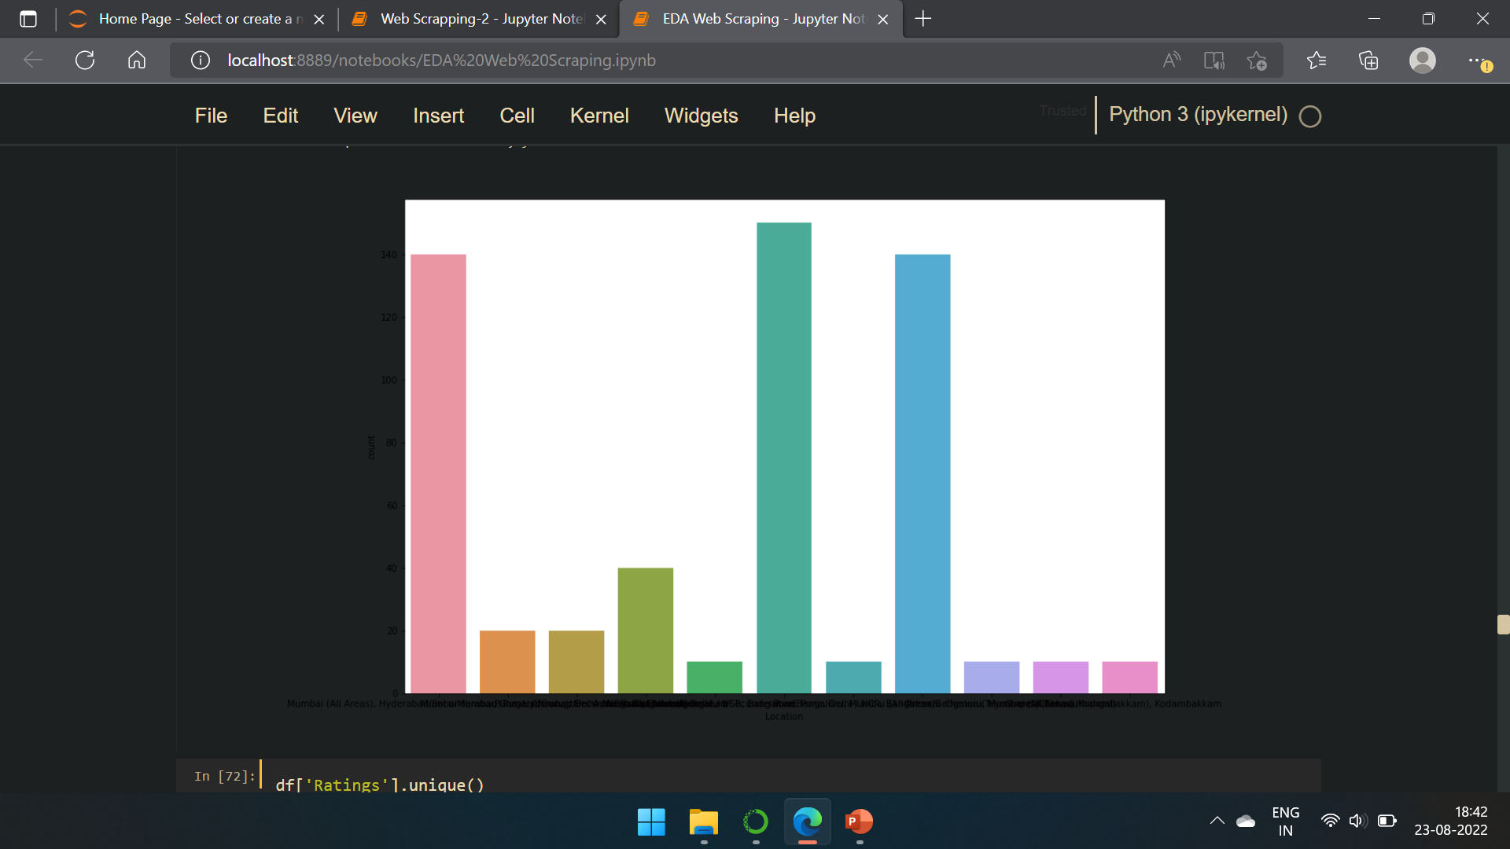
location

Slide 9
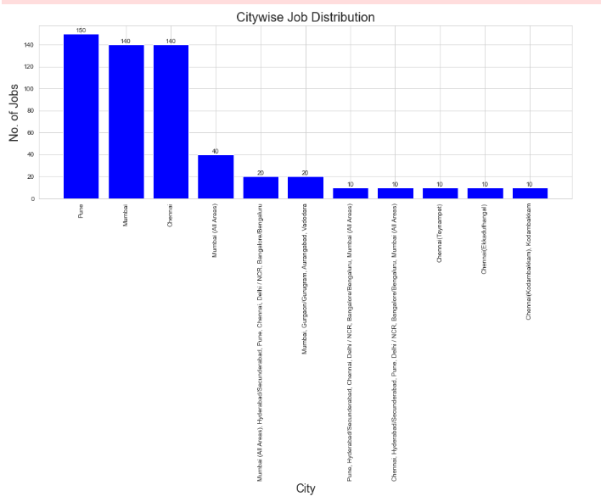
City wise Job Distribution

Slide 10
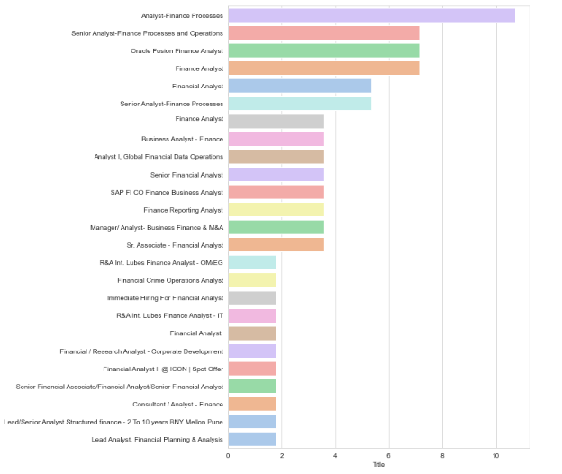
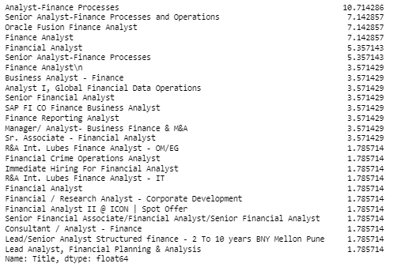
Salary Vs Job offered Trend

Slide 11
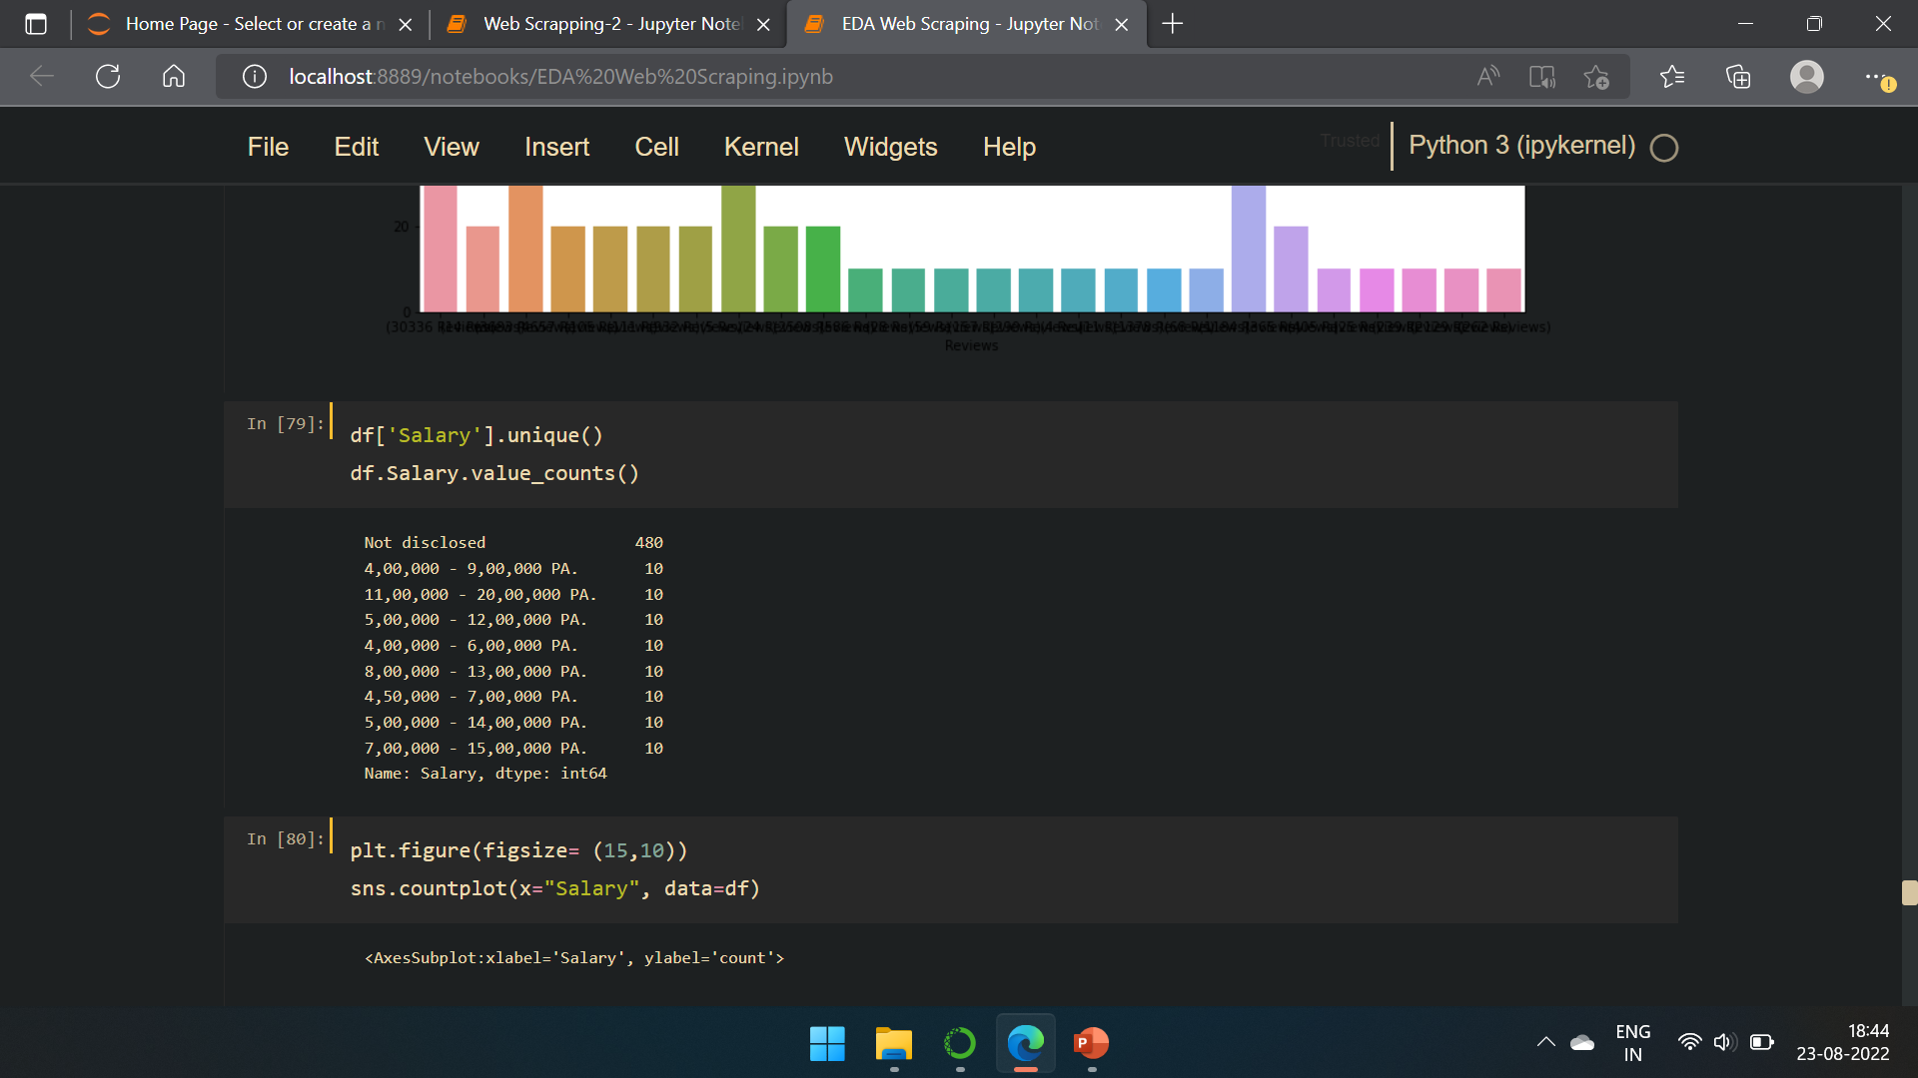
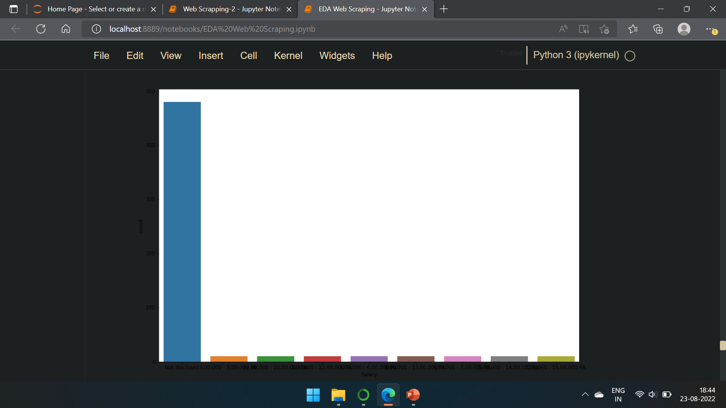
salary

Slide 12
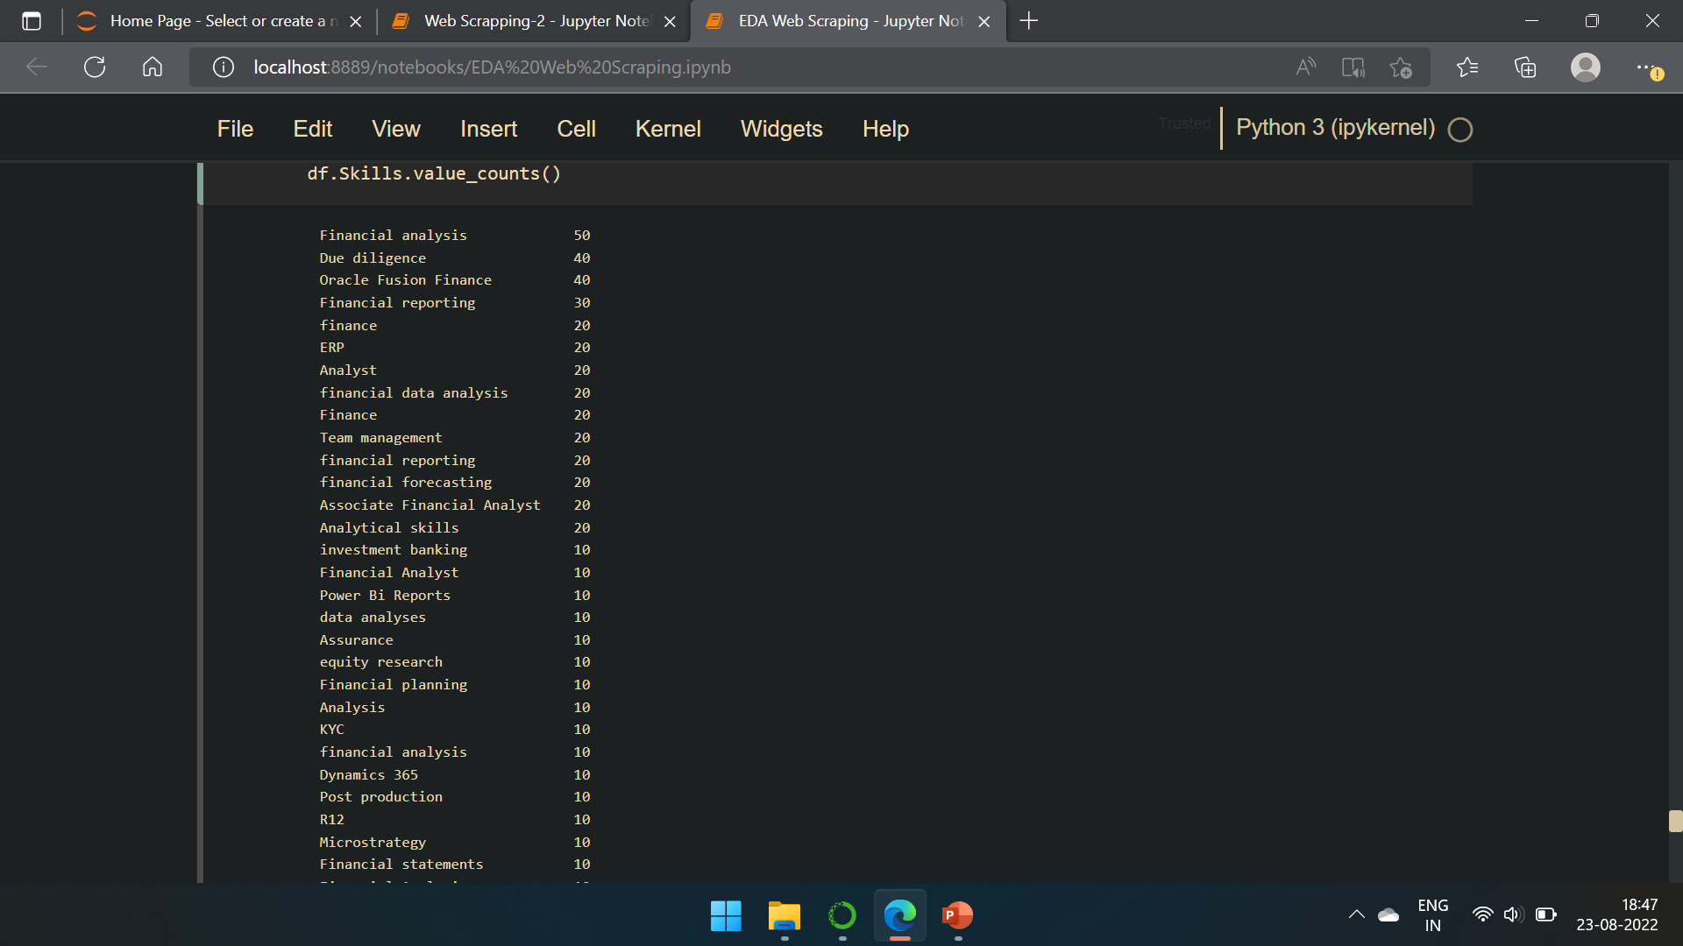
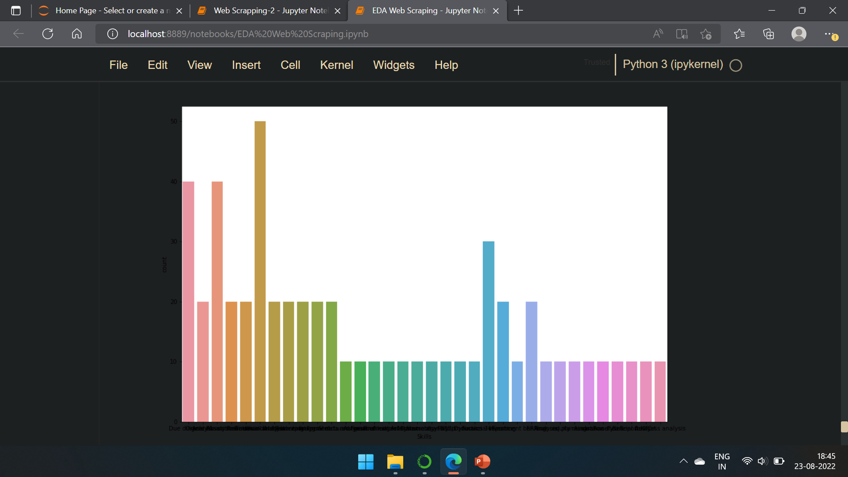
skills

Slide 13
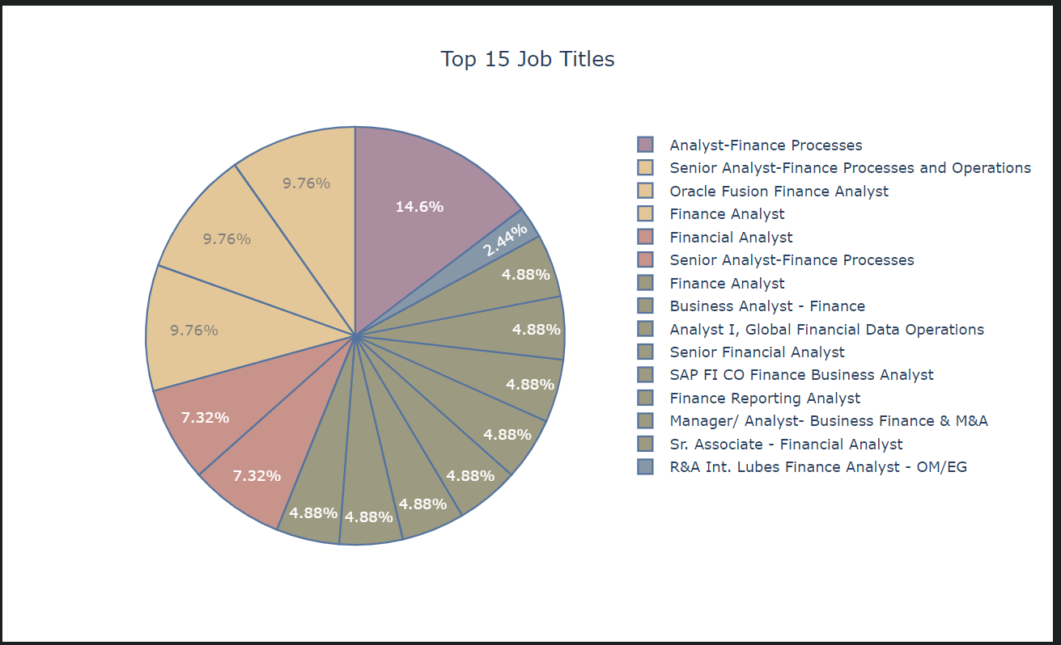
Top 15 job titles

Slide 14
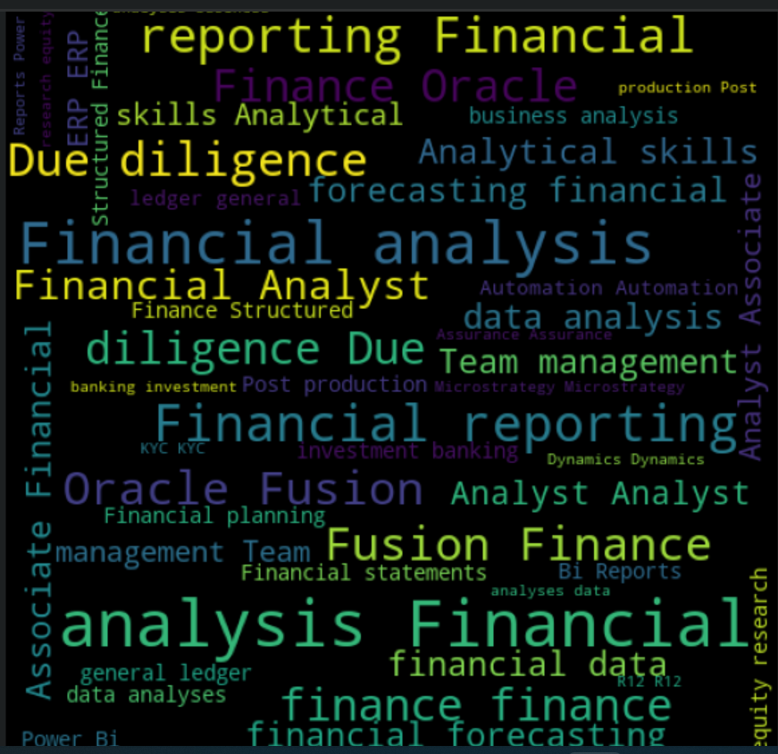
Skillsets word cloud

Slide 15
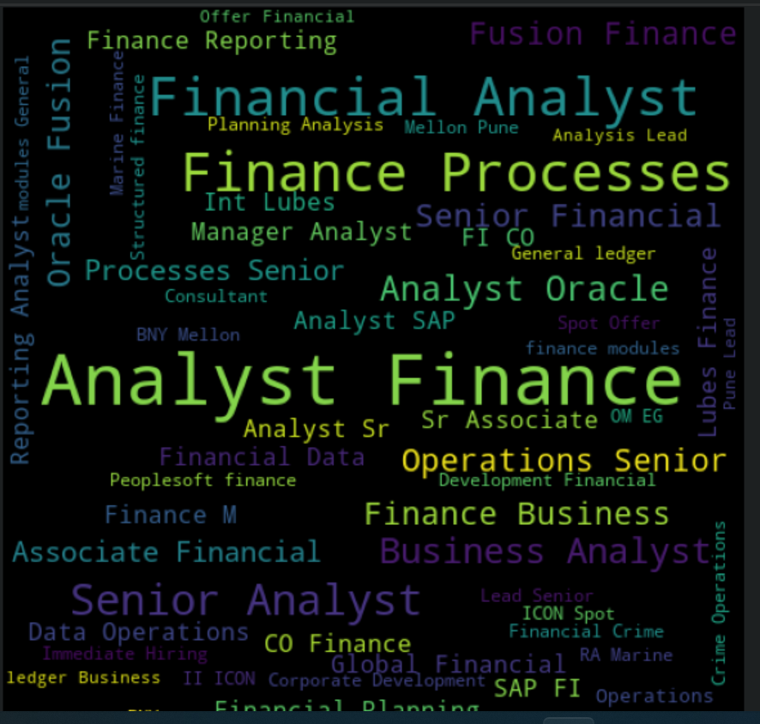
Job title word cloud

Slide 16
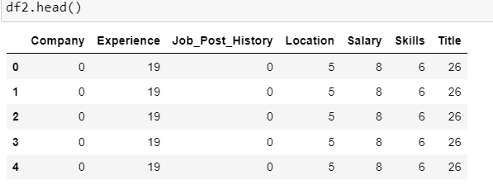
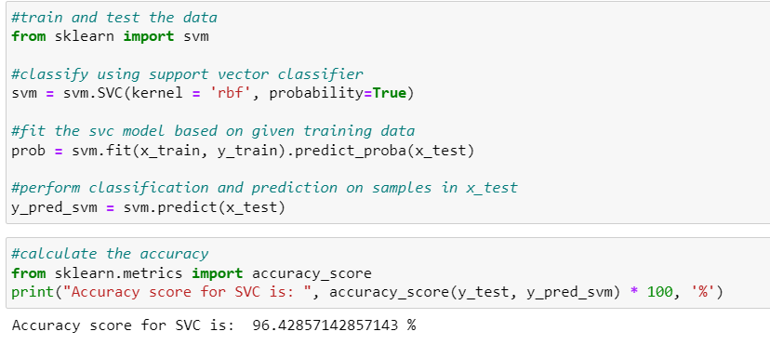
SVM

Slide 17
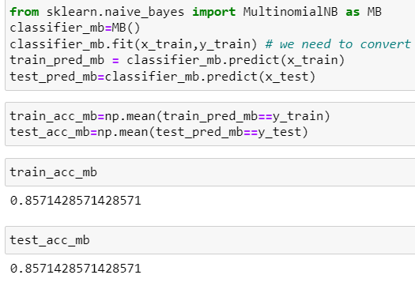
Naive Bayes

Slide 18
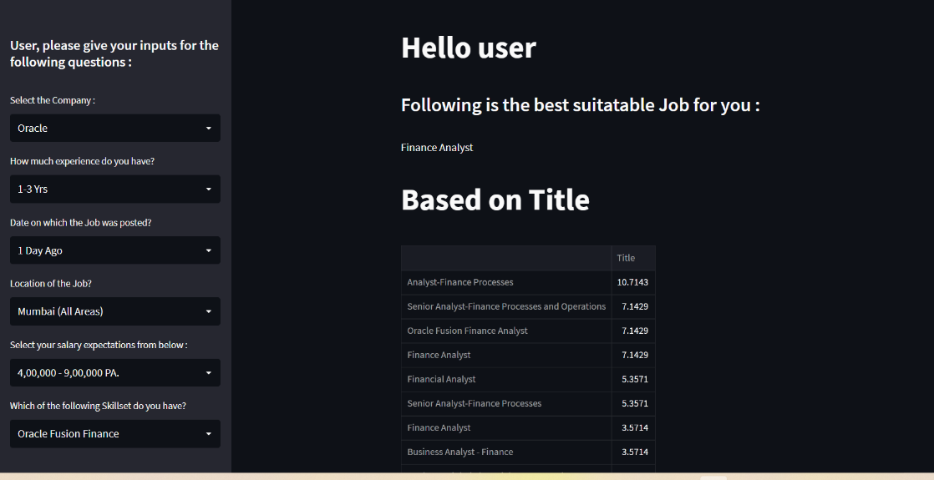
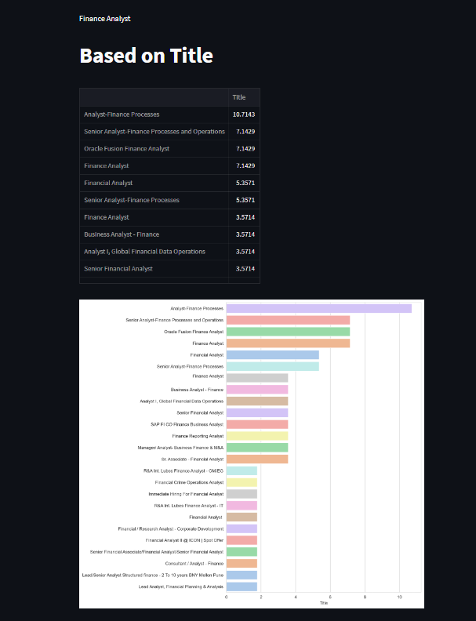
Model For deployment : svm using streamlit

Slide 19
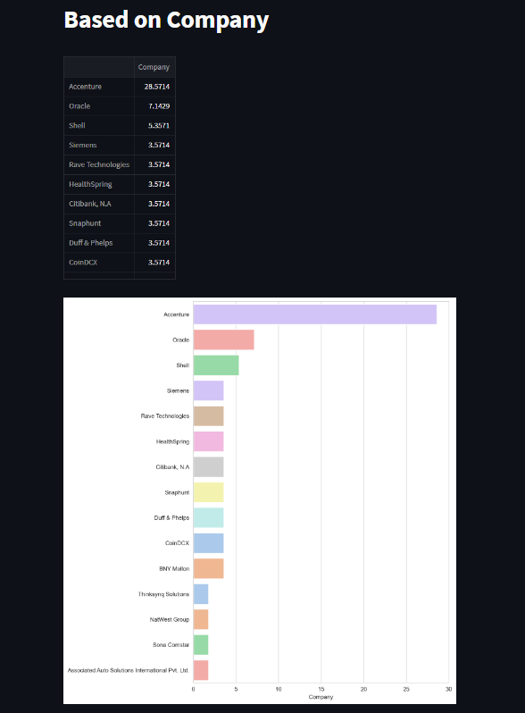
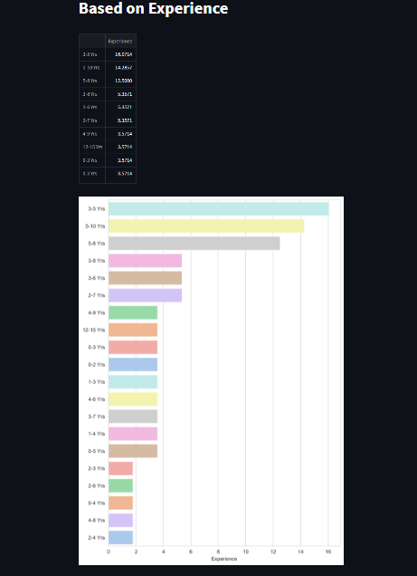
Screenshots continued…

Slide 20
Thank You

